Slide 1
Brain Tumor MRI Image Classification

Slide 2
Problem Statement
Brain tumor detection is crucial for early treatment.
Manual MRI analysis is slow and prone to human error.
Goal: Build a CNN model to classify MRI images into tumor types.

Slide 3
Dataset
MRI brain scan images.
Four classes:
  glioma
  meningioma
  no tumor
  pituitary
Data split into training, validation, and testing.

Slide 4
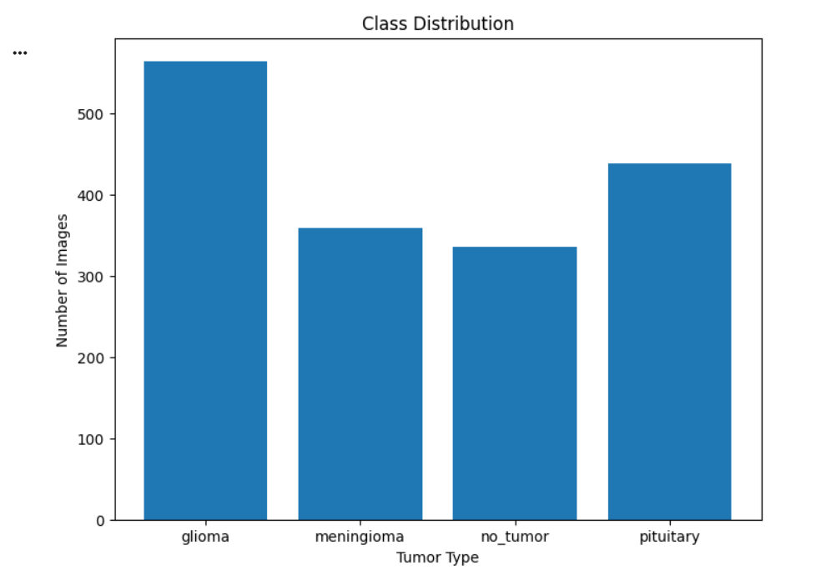
Class Distribution
This bar chart displays the number of MRI images available for each tumor type:
Glioma - 570 images
Meningioma - 360 images
No Tumor - 335 images
Pituitary - 440 images

Slide 5
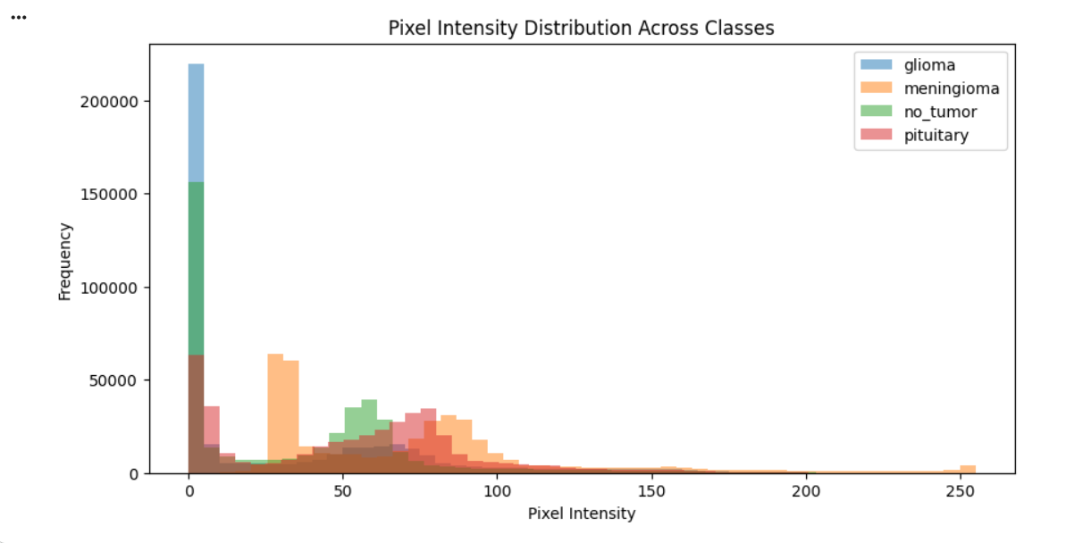
Image Pixel Intensity Distributions Visualization

Slide 6
This histogram compares the pixel intensity values (0–255) across all four classes.
MRI images differ in contrast and brightness depending on tumor type.
Glioma and no_tumor show higher frequencies of darker pixels (intensity near 0).
Meningioma and pituitary tumors have slightly brighter intensity patterns.
These differences help the model learn texture-based and brightness-based features for classification.

Slide 7
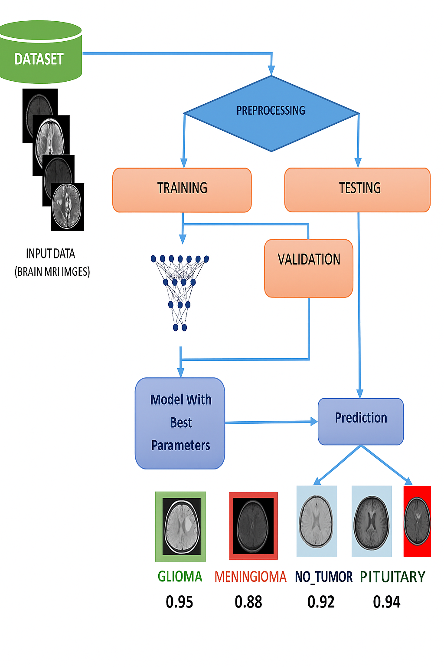
Flow Chart

Slide 8
Data PreProcessing
Image Resizing:
MRI images come in different resolutions.
To maintain consistency and reduce computation the image is resized all to a fixed size
Normalization:
Improves CNN learning speed.
Moves values from 0–1

Slide 9
Data Augmentation
Used only for Training to avoid overfitting.
Include:
Rotation (+ -10°)
Zoom (0.1)
Width/height shift (0.1)
Horizontal flip
Shear transformation
Brightness change (0.8–1.2)

Slide 10
CNN-Convolutional Neural Network
A deep learning model specialized for image data.
Designed to automatically learn spatial patterns, such as edges, textures, shapes, and objects.
Uses convolution operations to extract important visual features from images.
Widely used in computer vision tasks like classification, segmentation, and detection.

Slide 11
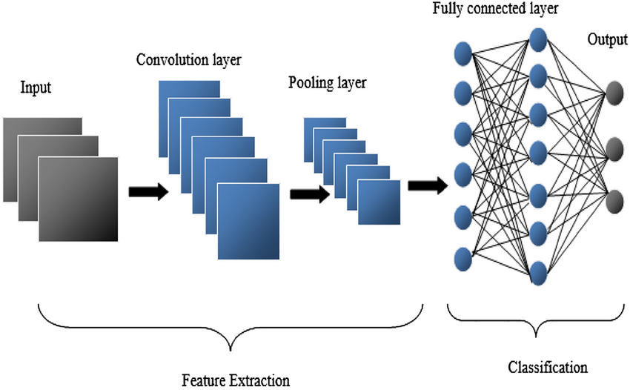
CNN-Convolutional Neural Network

Slide 12
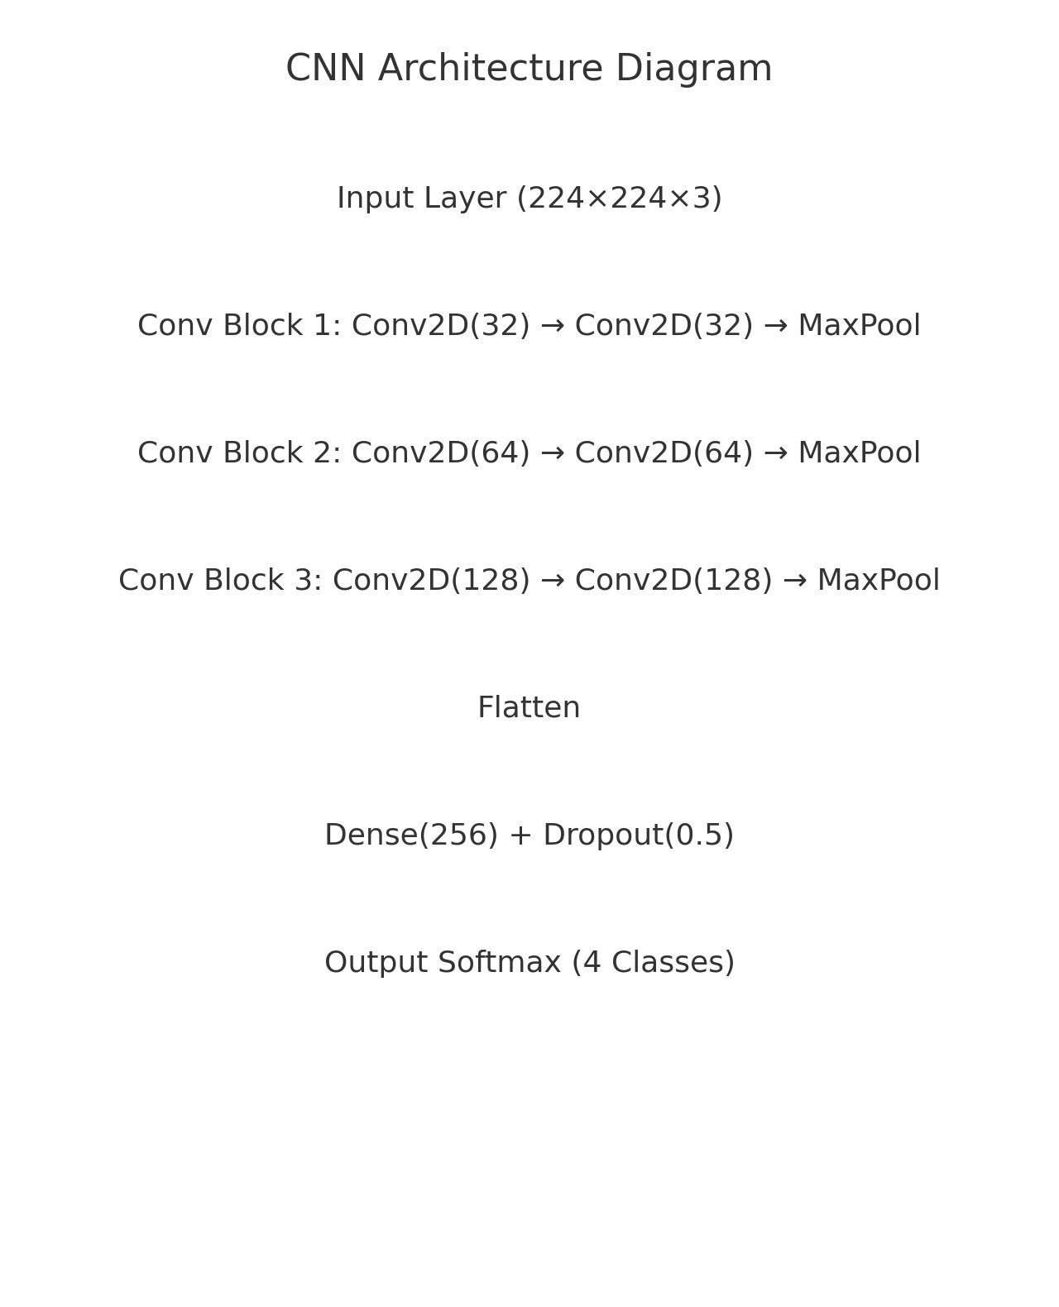
CNN Architecture Diagram

Slide 13
Build the CNN Model
Create a custom deep CNN architecture.
Use ReLU activation, MaxPooling, Dropout, and Softmax output.

Slide 14
Training
Train the model on MRI dataset.
Use callbacks:
  EarlyStopping (prevents overfitting)
  ModelCheckpoint (save best model)

Slide 15
Transfer Training Model Comparison
EfficientNetB0 | MobileNetV2
Higher accuracy (0.82) | Lower accuracy (0.76)
EfficientNetB0 is more accurate | MobileNetV2 is faster and lighter
Advanced feature extraction and Better for complex MRI tumor patterns | Suitable when speed is more important than highest accuracy
Provides higher accuracy due to its deep and balanced architecture | Requires less memory and computational power
Requires more computation but results in better diagnosis accuracy | Trains quickly due to lightweight architecture

Slide 16
Model Evaluation
We compute:
Accuracy
Precision
Recall
F1-Score
Confusion Matrix
Loss/Accuracy curves

Slide 17
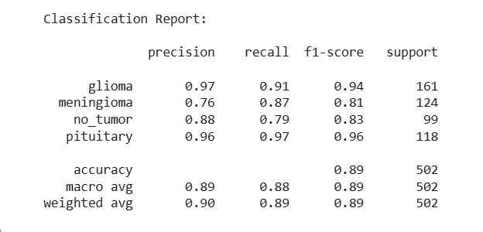
Model Evaluation

Slide 18
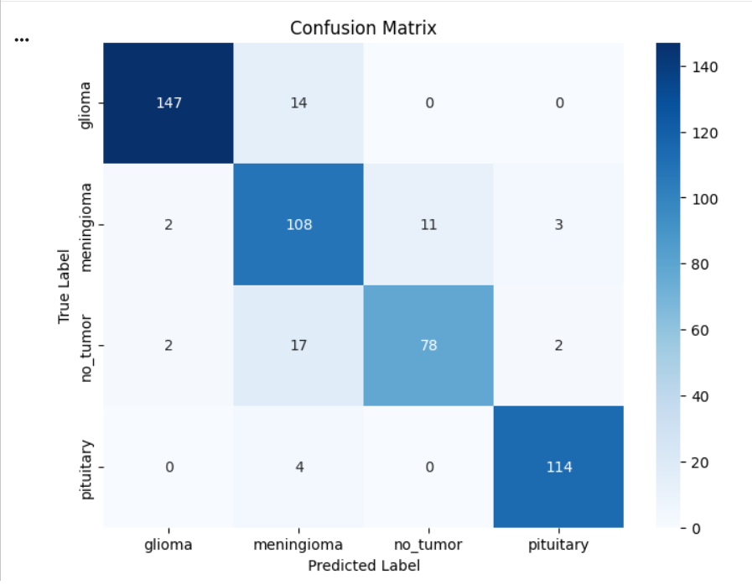
Confusion Matrix

Slide 19
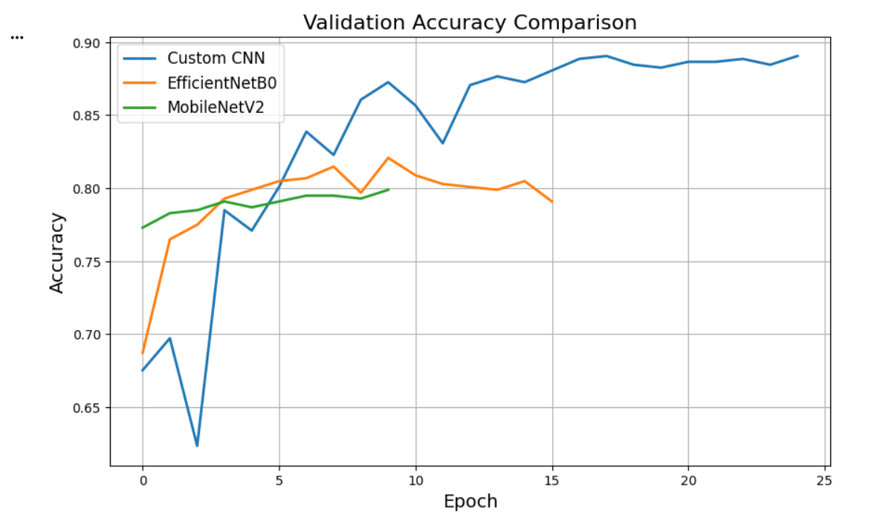
Validation - Accuracy

Slide 20
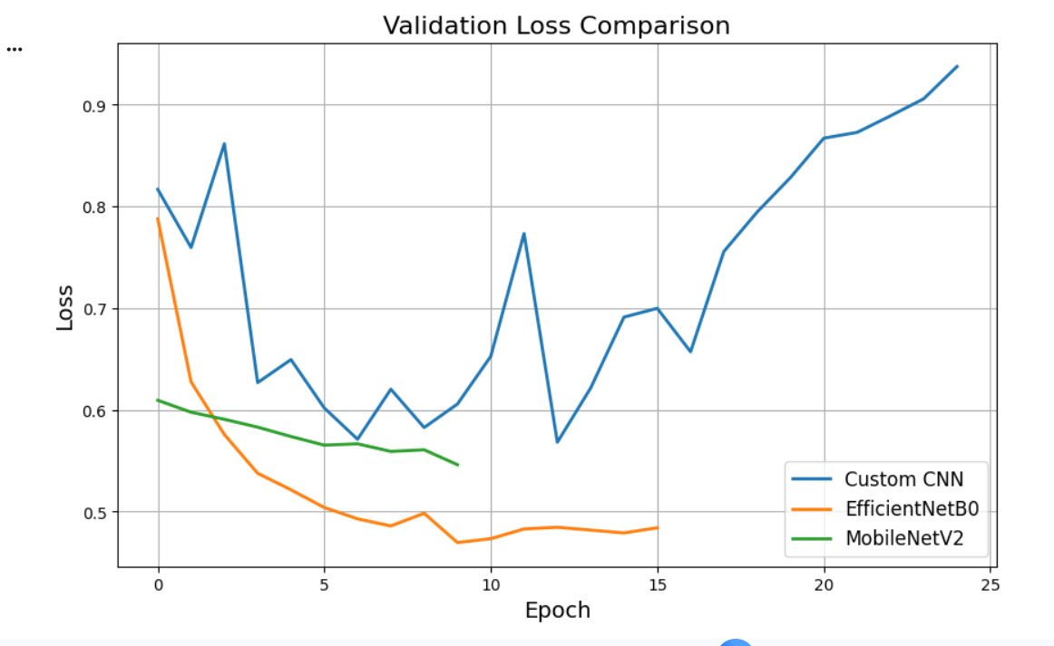
Validation - Loss

Slide 21
Validation Accuracy & Loss Comparison
  • EfficientNetB0 minimizes loss but accuracy remains lower (overfitting)
  • MobileNetV2 shows stable loss but low accuracy (underfitting)
  • Custom CNN shows higher loss but best accuracy (generalization)

Slide 22

Comparison With Transfer Learning
Compare custom CNN vs EfficientNetB0 vs Mobilenet V2.
Custom CNN performs best for this dataset

Slide 23
Comparison
  Custom CNN: 0.89 (Best)
  EfficientNetB0: 0.82
  MobileNetV2: 0.76
  Reason: Custom CNN generalizes better due to few parameters

Slide 24
Future Enhancement
Collect larger & balanced dataset
Use advanced data augmentation
Try medical transfer learning models
Ensemble multiple CNN models
Deploy model as web/mobile app

Slide 25
Deployment- Streamlit App
We build an interactive app where users can:
Upload an MRI scan
Get:
  Predicted tumor type
  Confidence score

Slide 26
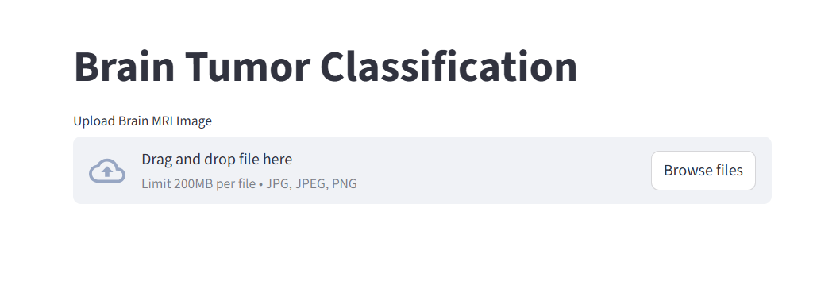
Streamlit App

Slide 27
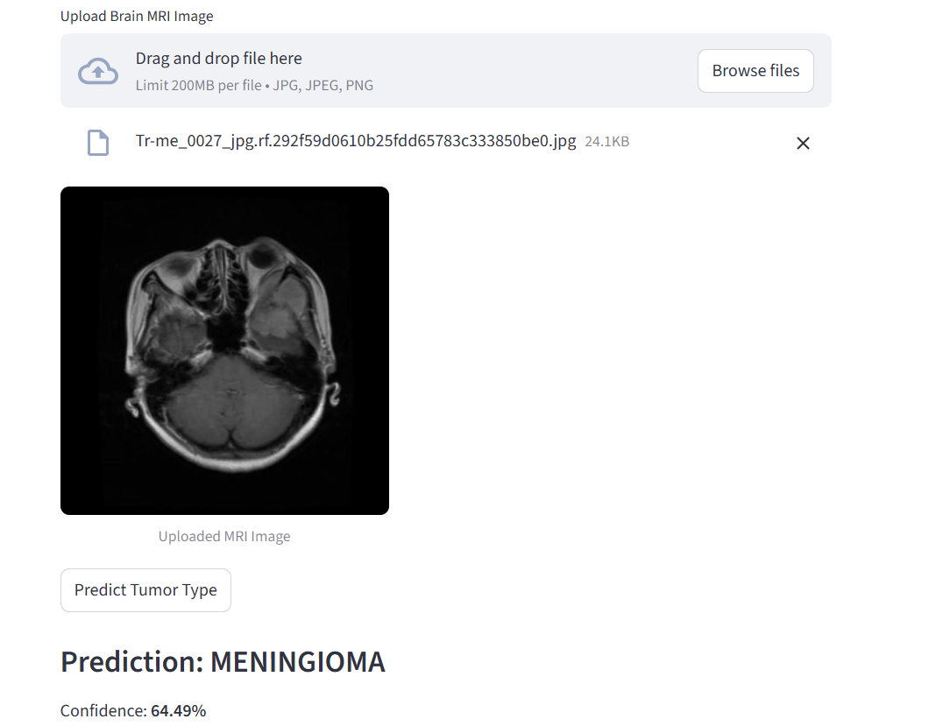
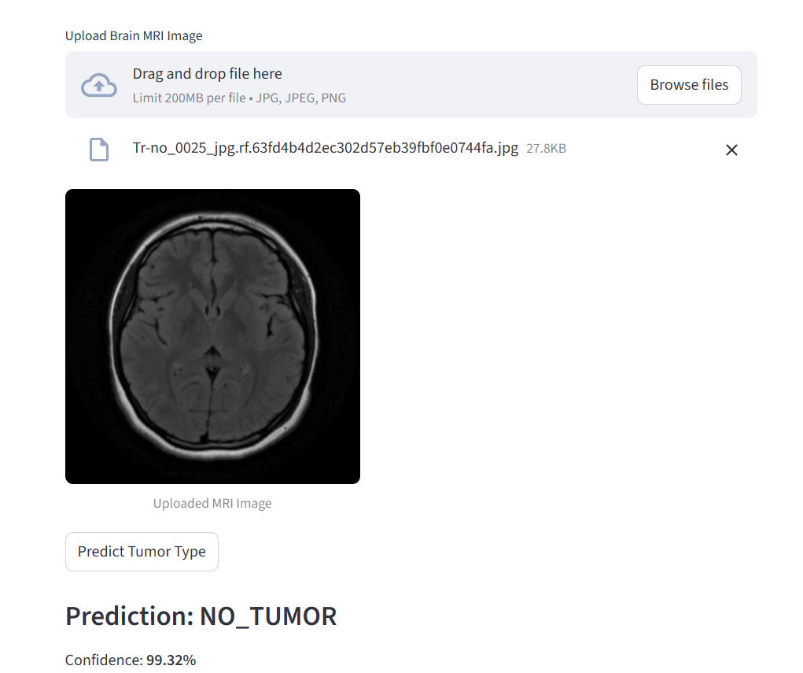
Streamlit App

Slide 28
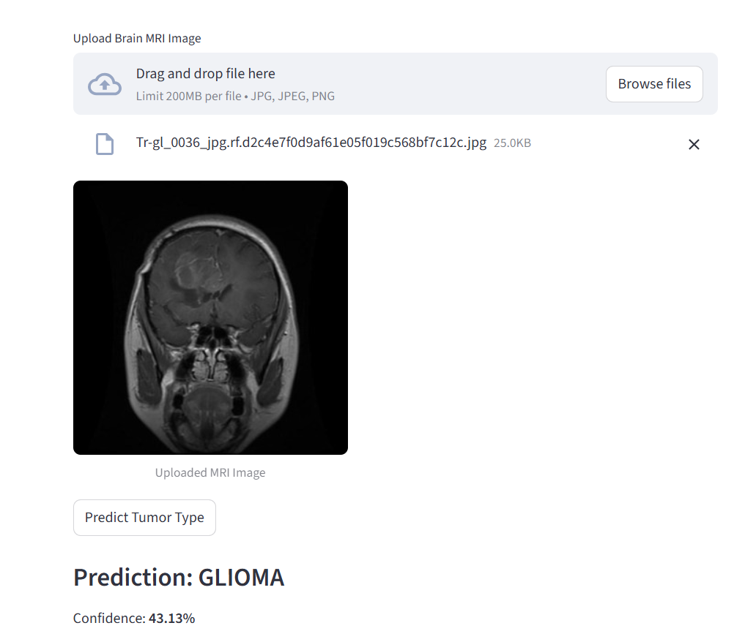
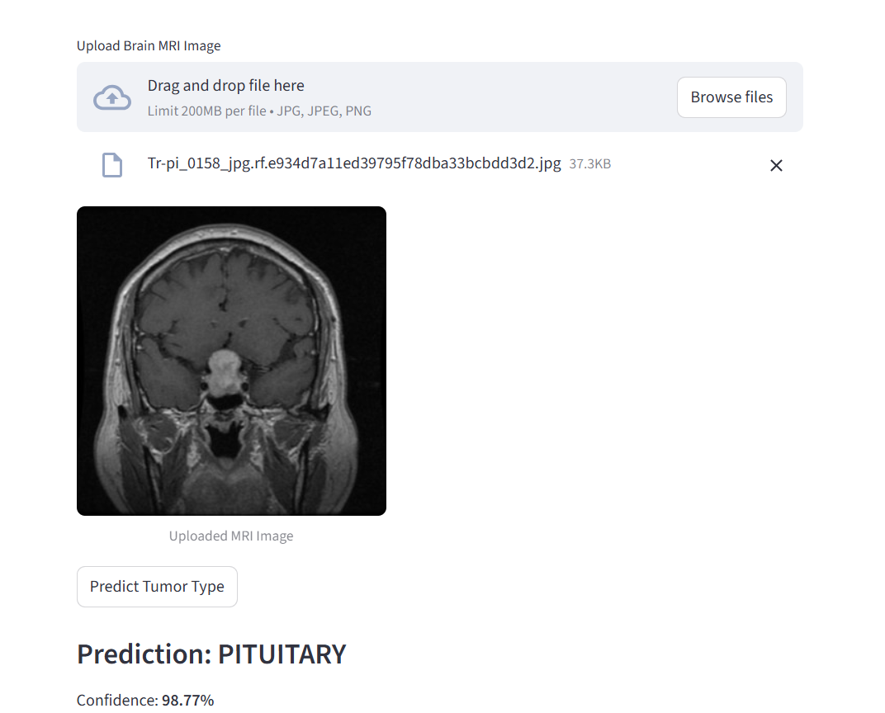
Streamlit App

Slide 29
Thank you

